Slide 1
Establishing a Just,
Learning Culture
Nardos Gebremedhin

Slide 2
What is a “Just Culture”?
A Just Culture is an organizational mindset and framework that balances accountability with learning
Not about punishment: avoids automatic blame or retribution
Restorative justice: understands why mistakes happen, addresses systemic issues, supports improvement
Encourages openness: safe reporting without fear of unfair punishment
Improves safety: transparency enables learning, reduces risks, prevents harm
Core principle: human error is inevitable; response determines safety outcomes

Slide 3
Challenges
Superficial adoption: Practices are often imposed without addressing deeper values, behaviours, and systems
External pressures: Legal, regulatory, and media environments often push organizations back toward blame and scapegoating
Focus on failures only: Just Culture tends to emphasize learning from harm rather than also studying successes
Difficulty embedding sustainably: Many organizations struggle to make Just Culture “stick” and revert to punitive methods

Slide 4
what a Just Culture looks like
Based on Ashish Jain’s description, a “Just Culture” in tech balances accountability with learning, while examining the processes, tools, and structures behind mistakes. Employees feel safe to report issues without fear, and the organization supports innovation and complex problem‑solving. Leaders and teams openly share failures, turning them into opportunities for growth and continuous improvement.

Slide 5
How to Start a Just culture
Model openness at the top: Leaders share mistakes and lessons learned to set the tone
Distinguish behaviors: Separate human error from reckless actions; respond fairly and proportionally
Encourage reporting: Create a safe environment for employees to raise issues without fear of punishment
Focus on systems, not individuals: Analyze processes, tools, and structures behind mistakes instead of blaming people
Build team rituals: Use blameless postmortems and open discussions to normalize learning from failure

Slide 6
Benefits
Promotes learning, justice and safety: Helps organizations move from blame to forward-looking, change-oriented improvement
Encourages reporting and openness: essential for a reporting culture where people feel safe to share incidents, near misses, and unsafe conditions
Balances accountability with learning: Recognizes human error as inevitable and avoids punitive responses that obstruct improvement
Supports psychological safety: Creates environments where staff can speak up without fear, enabling candid communication and reducing harm

Slide 7
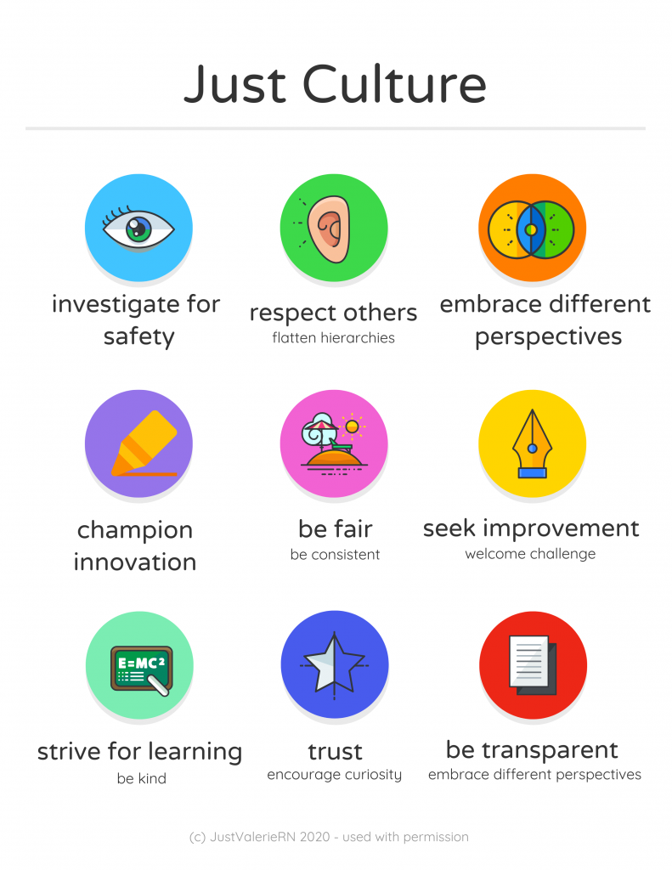
Notes:
Christman, & Ernstmeyer . (n.d.). Just culture. PressBooks. https://mlpp.pressbooks.pub/nursingsynthesisandcapstone/chapter/jc-basic-concepts/

Slide 8
Resources
Christman, & Ernstmeyer . (n.d.). Just culture. PressBooks. https://mlpp.pressbooks.pub/nursingsynthesisandcapstone/chapter/jc-basic-concepts/
Geraghty, T. (2025, September 4). Just culture. Psych Safety. https://psychsafety.com/just-culture/
Jain, A. (2025, July 18). From blame to balance: Why “Just culture” matters in tech too. LinkedIn. https://www.linkedin.com/pulse/from-blame-balance-why-just-culture-matters-tech-too-ashish-jain-zc5nc
Overcoming barriers to a just culture. Health Quality Alberta Just Culture. (n.d.). https://justculture.hqa.ca/overcoming-barriers-to-a-just-culture/
OpenAI. (2025). ChatGPT (40 mimi). https://chat.openai.com/chat

Slide 9
Thank you!

